Slide 1
INTERNSHIP STUDIO internship for ethical hacking task – 2
Harsh Rana

Slide 2
SUMMARY
An XSS (Cross-Site Scripting) vulnerability was identified on the http://testasp.vulnweb.com/ website. This vulnerability allows attackers to inject and execute arbitrary JavaScript code, potentially leading to session hijacking, data theft, or other malicious activities.

Slide 3
Vulnerability Details:
Vulnerability Type: Cross-Site Scripting (XSS)
Affected Component: Search functionality
Vulnerable Parameter: tfSearch
Attack Vector: Remote
Impact: High

Slide 4
Steps to Reproduce:
Configure Firefox to use Burp Suite as a proxy.
Visit http://testasp.vulnweb.com/ in Firefox.
Intercept the request using Burp Suite.
Enter `<script>alert(1)</script>` in the search box and submit the request.
Forward the response to Intruder in Burp Suite.
Set the injection point to the search parameter and input XSS payloads.
Begin the attack in Intruder.
Check for successful XSS payload execution in the responses.
Render the response in the browser to verify the payload execution.
Record successful XSS payload, vulnerable parameter, and steps to reproduce.

Slide 5
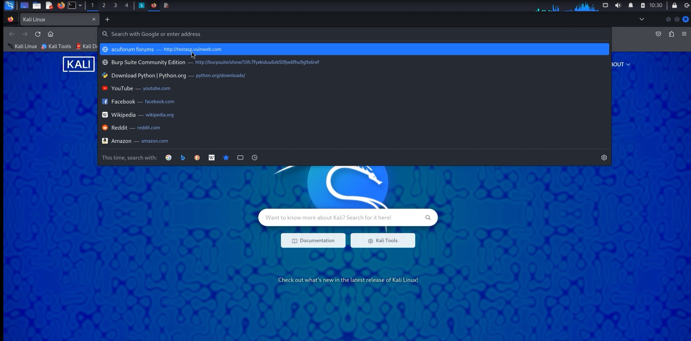
Proof of Concept (PoC):
SCREENSHOTS:

Slide 6
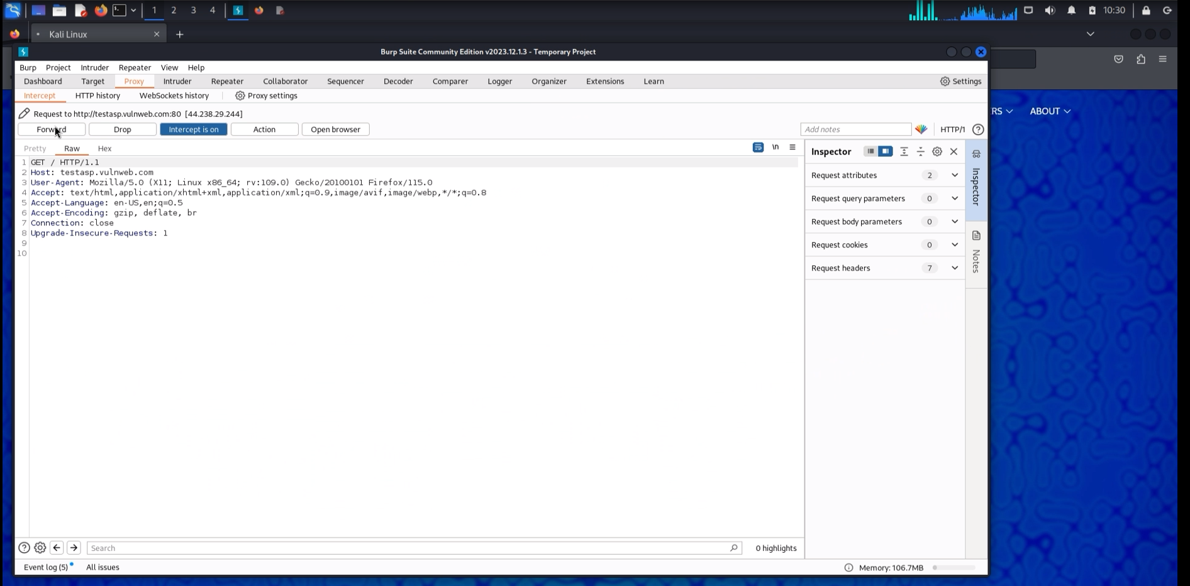

Slide 7
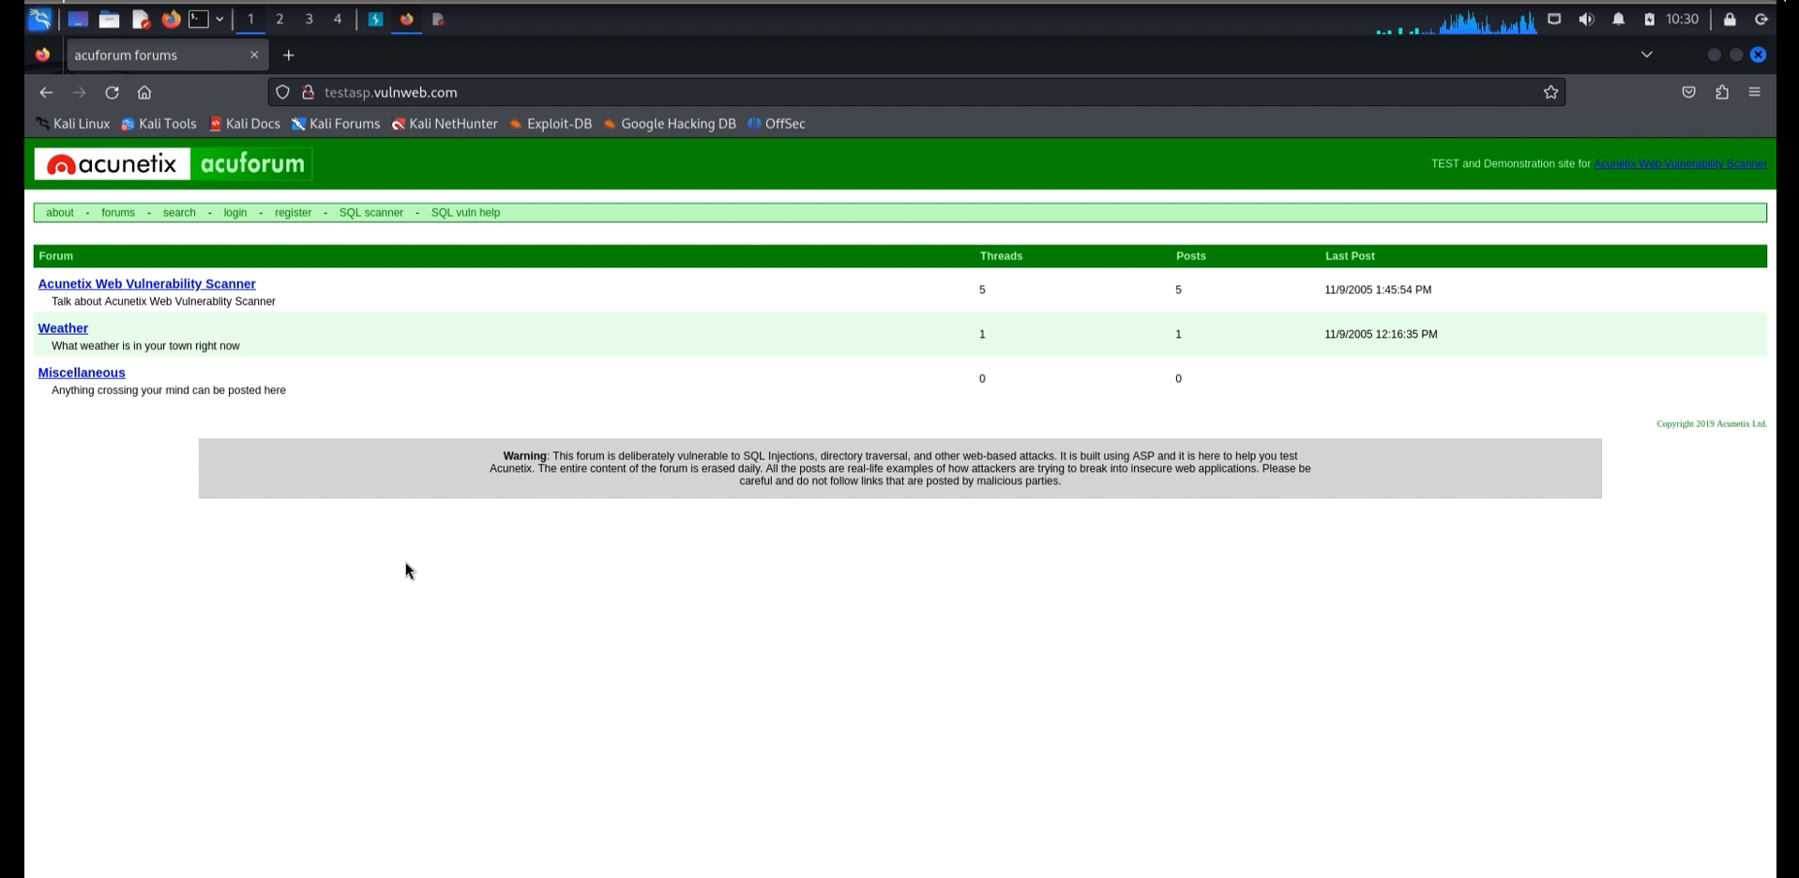

Slide 8
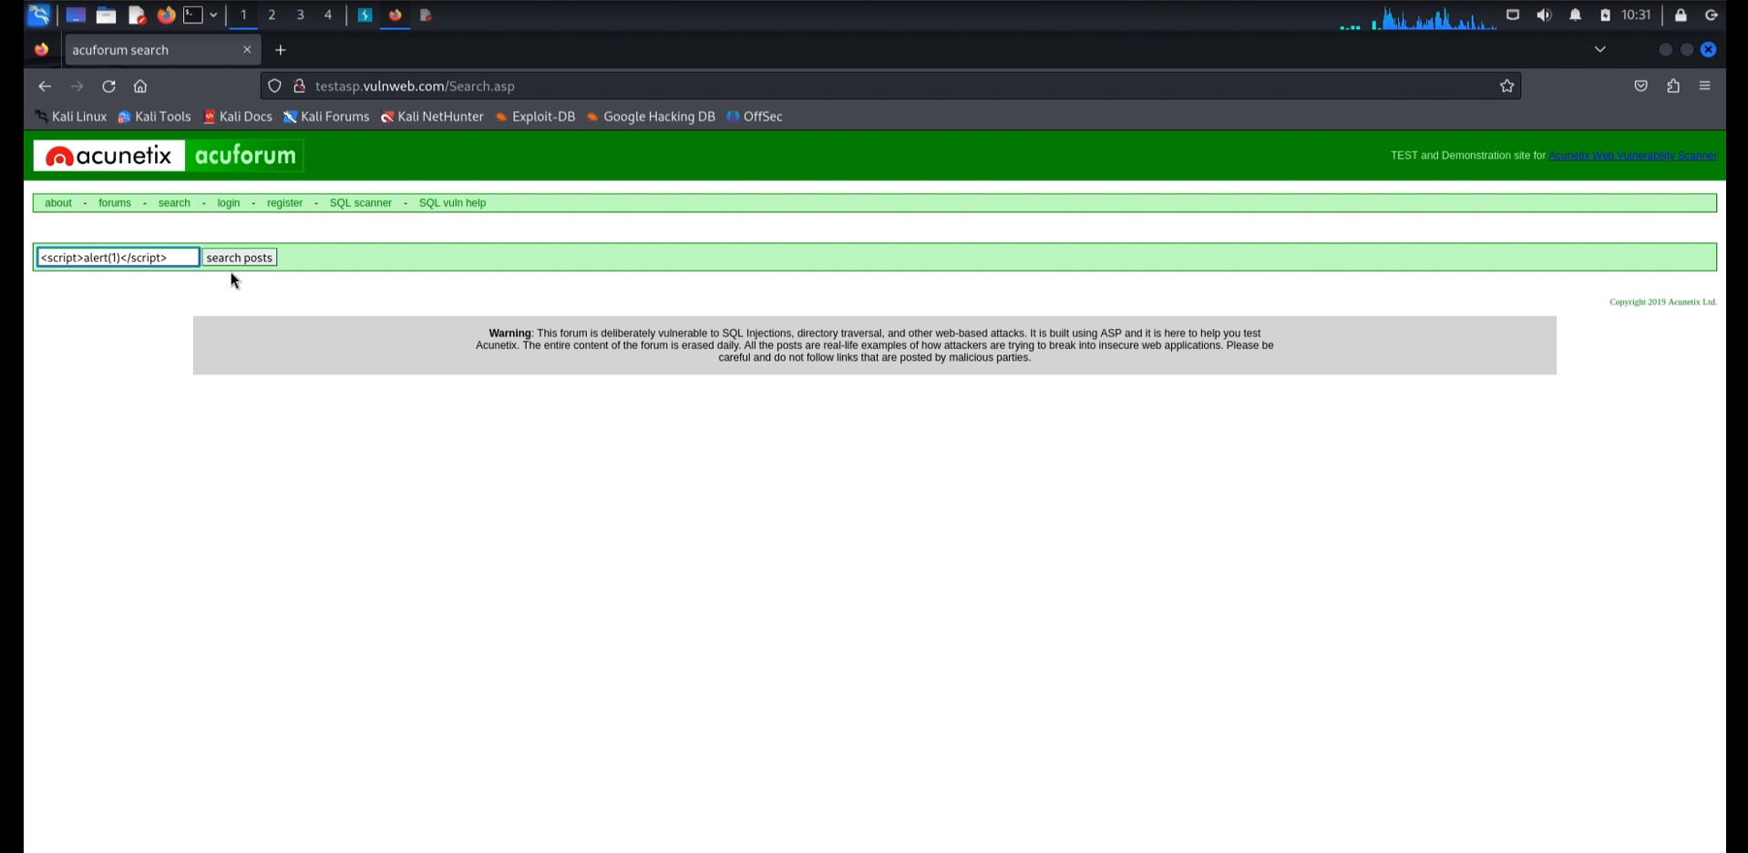

Slide 9
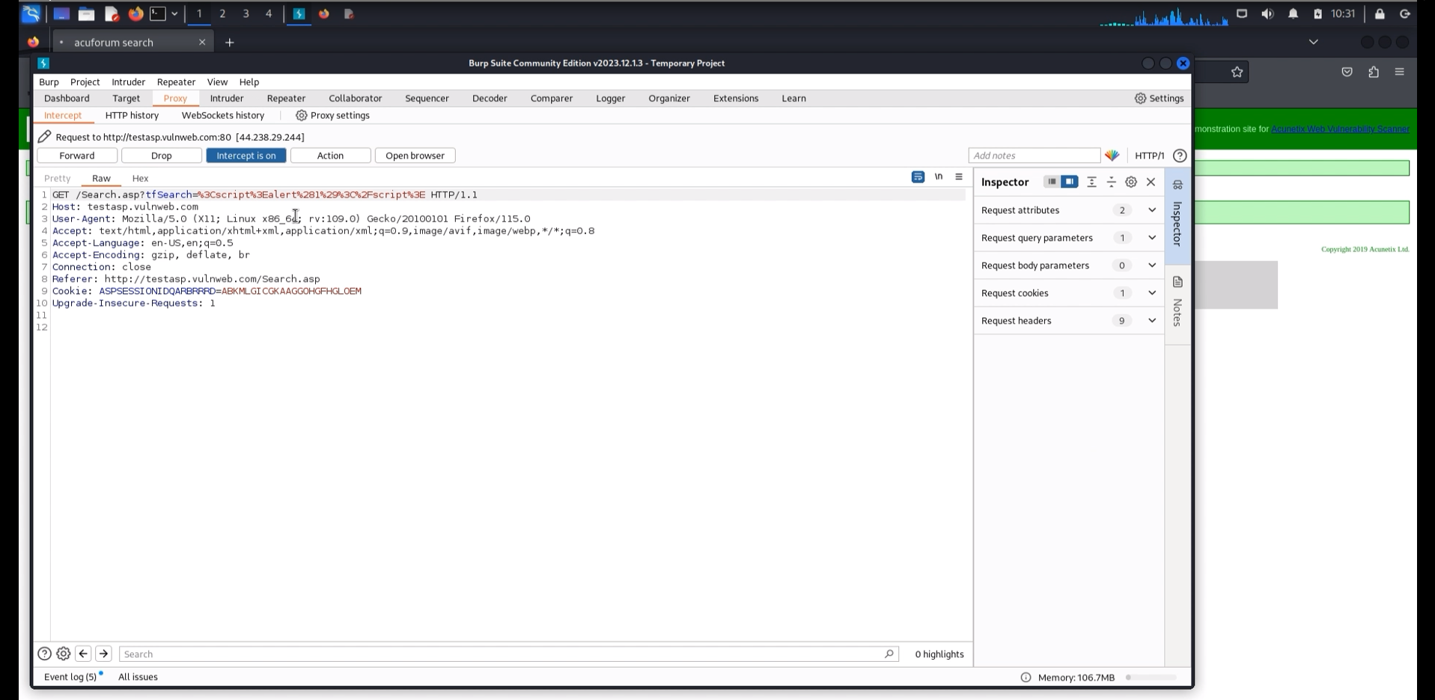

Slide 10
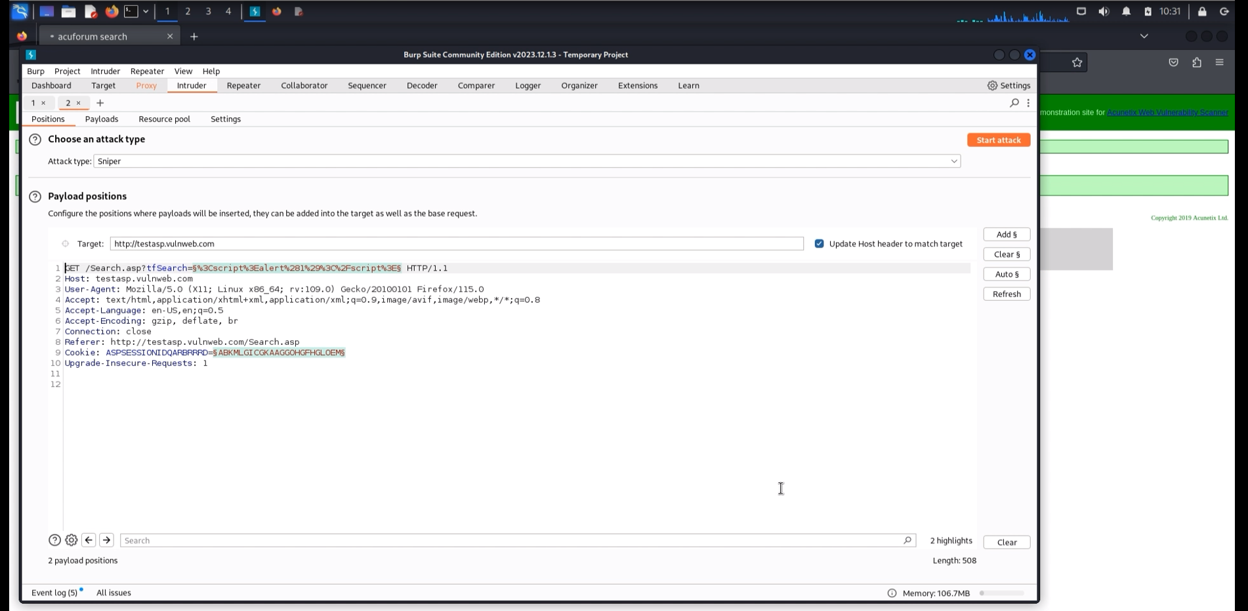

Slide 11
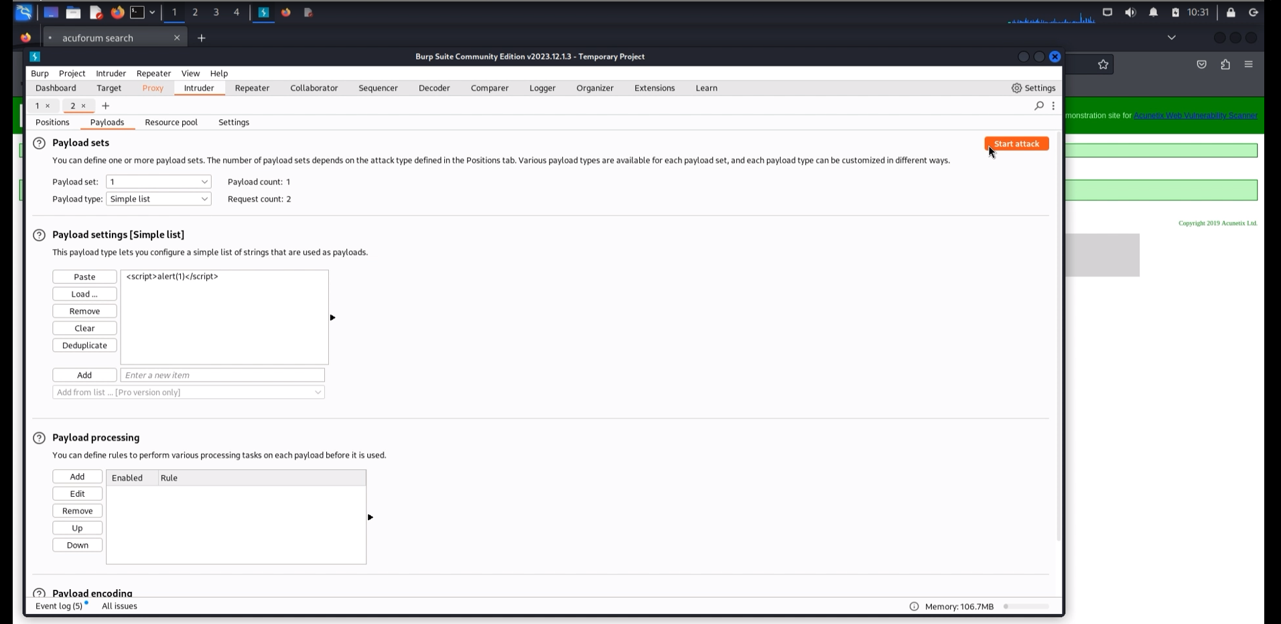

Slide 12
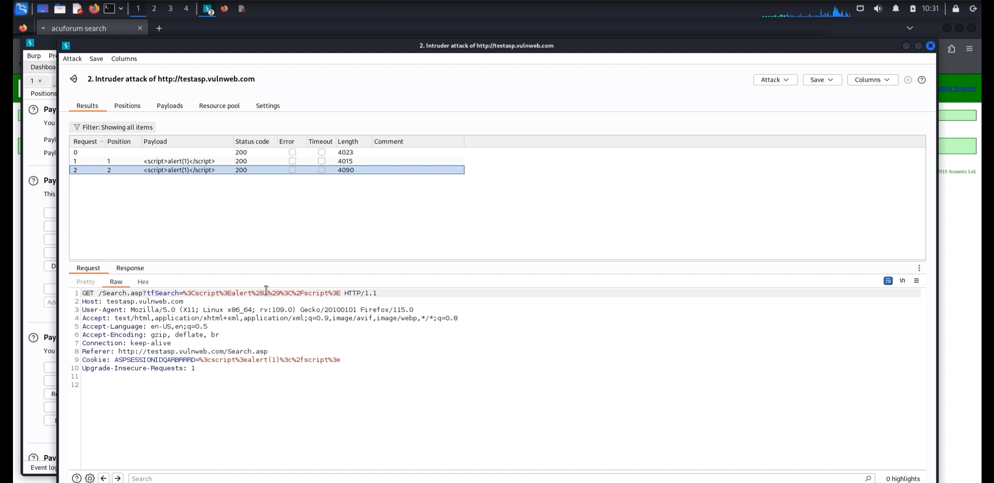

Slide 13
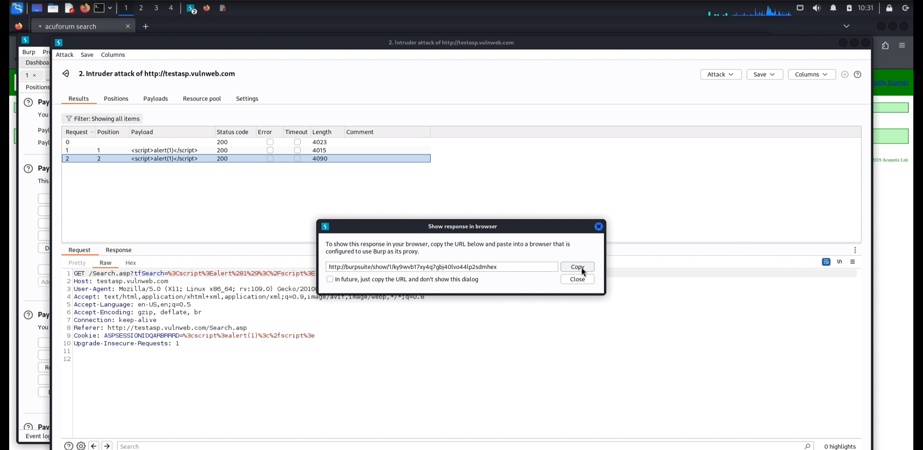

Slide 14
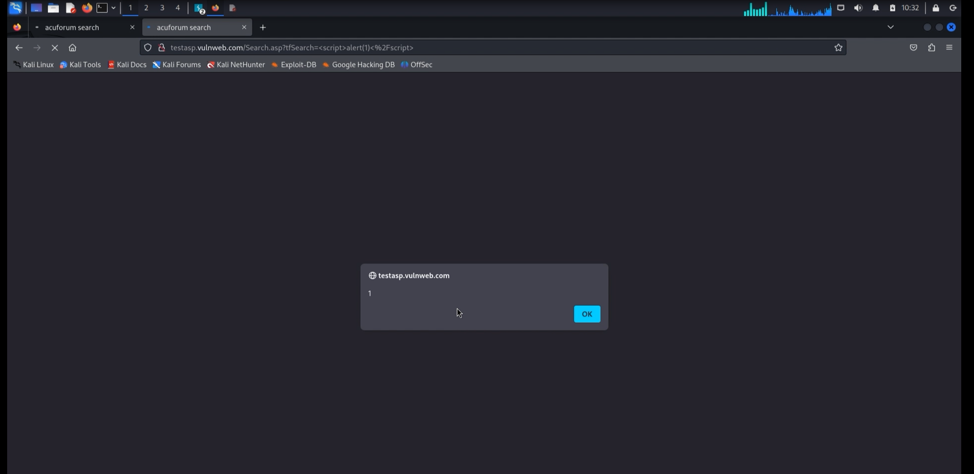

Slide 15
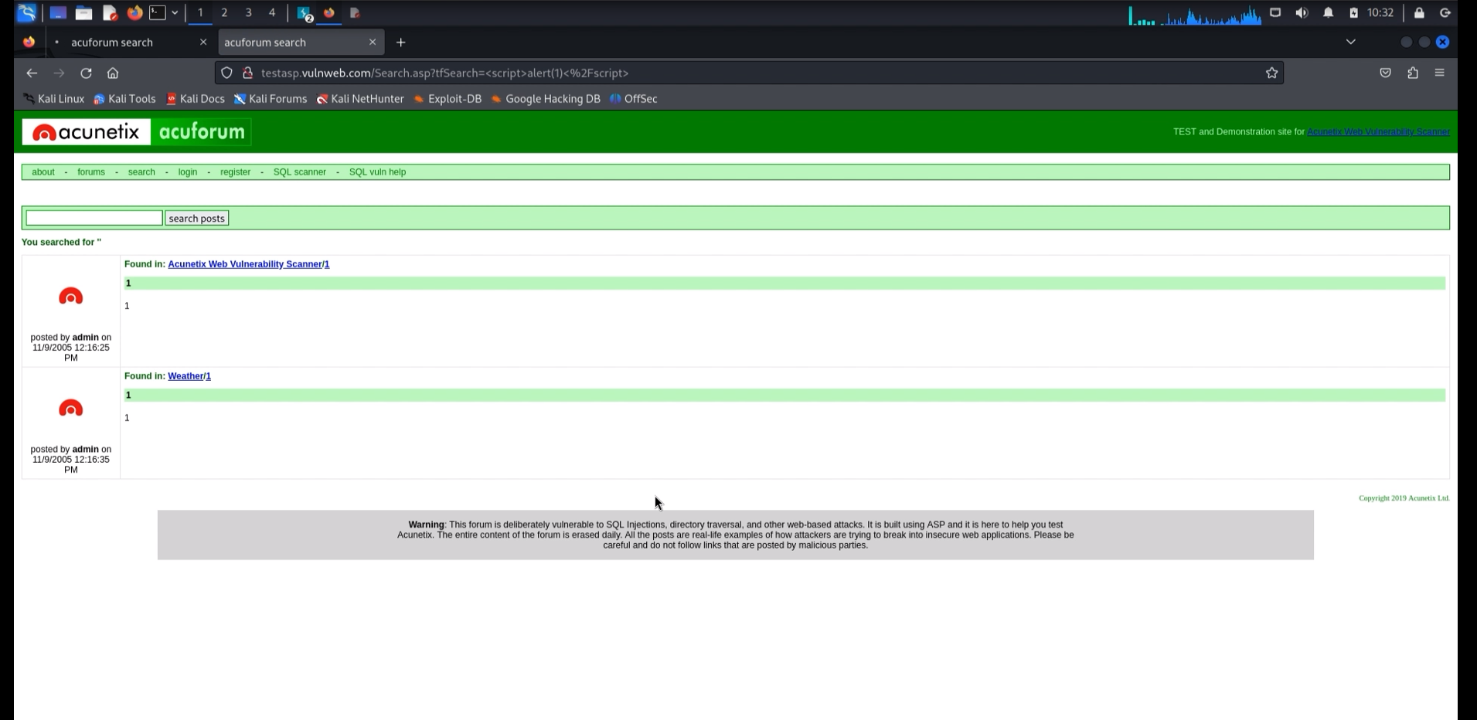

Slide 16
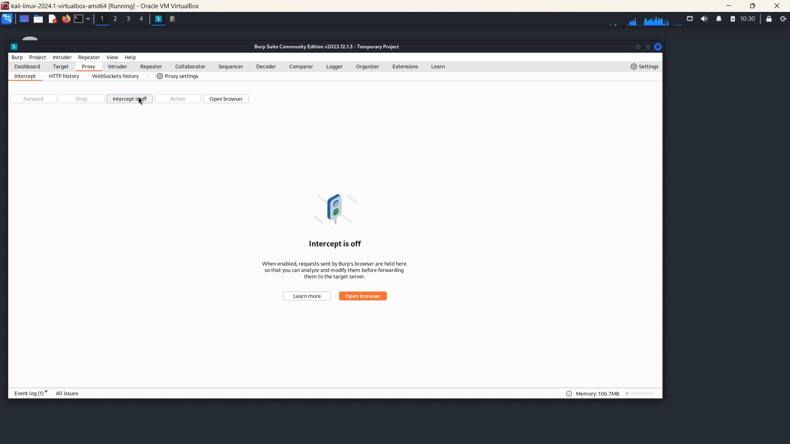
SCREEN RECORDING DEMONSTRATION:

Slide 17
IMPACT
Execution of arbitrary JavaScript code in the context of other users' sessions.
Potential for session hijacking, allowing attackers to take control of user accounts.
Theft of sensitive information such as cookies, personal data, and login credentials.
Possibility of redirecting users to malicious websites.
Manipulation of website content, leading to misinformation or defacement.

Slide 18
MITIGATIONS
Implement proper input validation to ensure only safe inputs are processed.
Apply output encoding to user-generated content before rendering it in the browser.
Use Content Security Policy (CSP) headers to restrict the sources from which scripts can be executed.
Regularly update and patch web applications to fix known vulnerabilities.
Conduct regular security assessments and vulnerability scans to identify and address potential security issues.
Educate developers on secure coding practices to prevent the introduction of XSS vulnerabilities.

Slide 19



Thank You
Harsh Rana
+91 7016200490
harshrana457@gmail.com
LinkedIn

